Slide 1
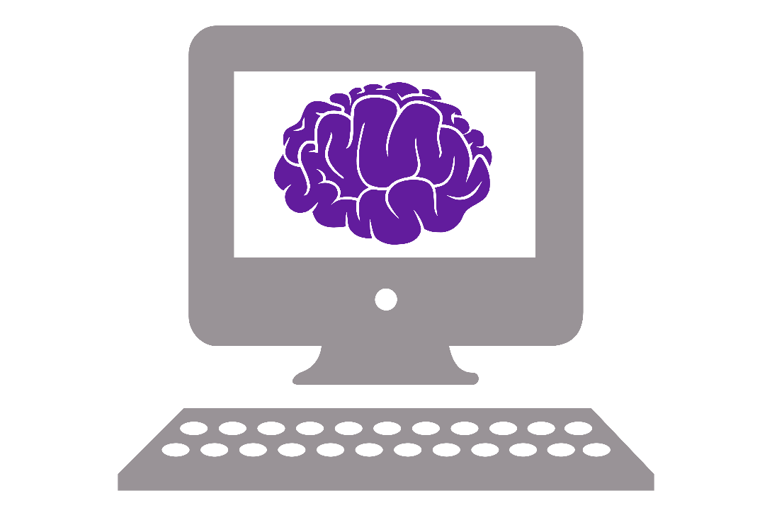
Sussex Neuroscience Python Course

Slide 2
What you will (hopefully) come away with
Basic understanding of Python
Use Python to make graphs
Know how to use Python to analyse your own data
Know how to look for help

Slide 3
However…
You can only learn how to code by doing!
Exercises during/after every session to help you gain experience
This course is not a magic coding potion

Slide 4
Course program
Session 1 (13 January)
9:30 – 10:30 Introduction to computer science
10:30 – 12:00 Introduction to Python
Session 2 (16 January)
Discuss last weeks exercises – do live coding of part 3 and any other exercises they found hard
13:00 – 14:00 Introduction to modules and Numpy
Session 3 (20 January)
11:30 – 12:30 Good coding practices
15:30 – 17:00 Introduction to data visualization with Matplotlib
Session 4 (23 January)
9:30 – 11:30 Data analysis with Python
Loading/saving data
Live coding of how I would attack a project
13:30 – 16:00 Discussion + project work

Slide 5
Structure of each part
Lecture (sometimes) – slides with information
Live coding – Jupyter Notebook with code and explanations
Exercises – Apply what you just learned in an exercise
Pair programming during the session
Take home the exercises

Slide 6
Rules for course
If you need to step out at any time, please do so
Ask questions any time
Be constructive when helping each other

